Slide 1
Working with traumatised children

Slide 2
The right to recovery
States Parties shall take all appropriate measures to promote physical and psychological recovery and social reintegration of a child victim of:
any form of neglect, exploitation or abuse
torture or any other form of cruel, inhuman or degrading treatment or punishment
armed conflicts.
Such recovery and reintegration shall take place in an environment which fosters the health, self-respect and dignity of the child.
United Nations Convention on the Rights of the Child

Slide 3
Impact of trauma on brain development and childhood learning
Brain development | Language delay; Learning difficulties; Memory loss; Hyper vigilance
Physiology | Sharpening peripheral vision; Auditory selection; Clumsiness
Physical | Numbness; Psychosomatic responses
Emotional | Numbing; Over reaction; No joy
Social Functioning | Others irrelevant/threatening. Learning in group very difficult. Focus on survival of self. Inability to construct meaning

Slide 4
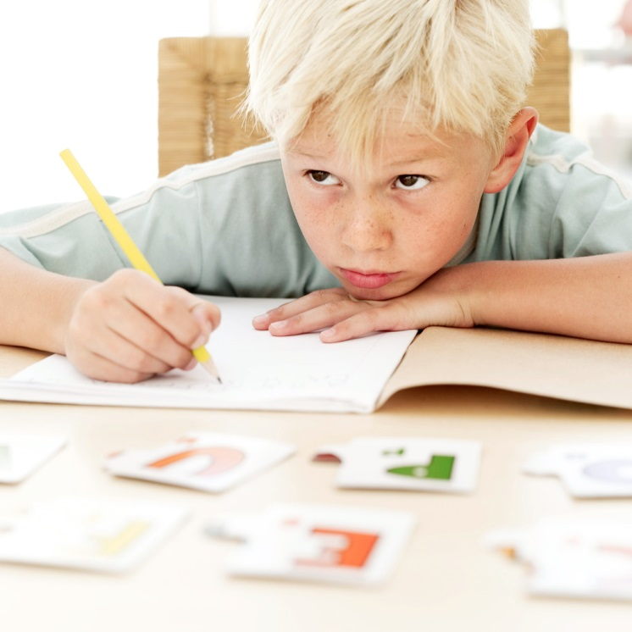
Impact of trauma on learning
Classroom learning cannot occur if the child is in either a persistent state of arousal and anxiety, or of dissociation. When in this state, the key parts of the cortex are not receptive to cognitive information that is not relevant to survival. The traumatised child's brain is
essentially unavailable to process efficiently the complex cognitive information being conveyed by the teacher.
Child trauma academy

Slide 5
Change in external challenge leads to change in internal state
Chronically traumatised children “re-set” their baseline state of arousal. Even when no external threats or demands are present, they will be in a physiological state of persisting alarm
The traumatized child will be more ‘reactive’ -- moving into a state of fear or terror in the presence of even minor stressors.
The cognition and behaviour of the child will reflect their state of arousal
This increased baseline level of arousal and increased reactivity in response to a perceived threat plays a major role in the behavioural and cognitive problems associated with traumatised children.

Slide 6
Hyperarousal continuum | Rest | Vigilance | Resistance | Defiance | Aggression
Dissociative Continuum | Rest | Avoidance | Compliance | Dissociation | Fainting
Regulating Brain Region | NEOCORTEX Cortex | CORTEX Limbic | LIMBIC Midbrain | MIDBRAIN Brainstem | BRAINSTEM Autonomic
Cognition | Abstract | Concrete | Emotional | Reactive | Reflexive
Sense of time | Extended future | Days/ hours | Hours/ minutes | Minutes or seconds | Sense of time lost
Mental state | Calm | Arousal | Alarm | Fear | Terror
Adapted from Perry, B. “Effects of Traumatic Events on Children” published on www.childtrauma.org

Slide 7
Know the stage!
and
Watch the state!

Slide 8
Changing the fundamental question from
“What's wrong with you?"
to
"What's happened to you?"
Sandra Bloom

Slide 9
S.E.L.F.
Safety: Physical, Psychological, Social, Moral
Emotions: Handling feelings without becoming destructive of self or other
Loss: Getting over loss, preparing for change
Future: Re-establishing the capacity for choice
The Sanctuary Model

Slide 10
ARC approach to trauma
Attachment
Regulation
Competency
http://www.traumacenter.org/research/ascot.php

Slide 11
Making Space
Staged
Predictable
Adaptive
Connected
Enabled
Making space for learning: trauma informed practice in schools

Slide 12
A feeling of safety?
At times I don’t feel safe , to be honest with you, when I’m lying in my bed at night …..I’ve always got to know that there are people sitting with me or that there are people thinking about me and are out there and are just there- I don’t like thinking that there’s nobody there that there is nobody in the bit where I am. I feel scared at times, I feel that somebody is going to come and get me at times, just the things I’ve gone through
Let’s Face It! Who Cares? Scotland 2003

Slide 13
Secondary trauma
Trauma is contagious
Working with traumatised children can create secondary trauma in the adults around them
This can be transient or persistent and can affect feelings thought and behaviour.
Important to prevent, recognise and treat
Strategies for dealing with secondary trauma need to be organisational as well as individual
The qualities that make people capable of empathy are those which make them vulnerable to secondary trauma.

Slide 14
Stress regulation and the environment
The interaction between the environment and the individual is unique and each person is constantly changed by the impact their environment has on them
Most people can maintain their own equilibrium even in difficult environments but traumatised people often find it difficult to regulate stress and maintain equilibrium - their physical environment has a powerful effect on them
Notes:
Although we can draw on theory, observation and practice to understand child development we need never to forget that individual experiences may challenge our expectations and certainties. Two children in the same family may have radically different environments and their genetic heritage ill also affect the way they interact with it.

